Slide 1
New Zealand Road Accident Study
Jadon Couch, Alec Lolly-Wilson, Nic Duffee

Slide 2
Scope
01. Why NZ Crash Data?
02. The Data
Why we chose this topic and what were the questions we asked?
Where did we get our data and what did it contain?
03. The Approach
04. Our Findings
05. Demonstration
How the project was structured and what tools we used?
What did we learn from the data and what does it mean going forward?
A quick walkthrough of our visualization.

Slide 3
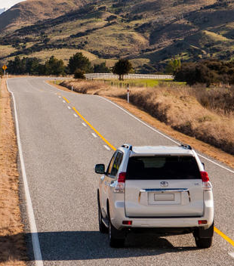
Why New Zealand Crash Data?
A 2018 study conducted by NZ Figures highlighted motor vehicle accidents as the leading cause of accidental death in New Zealand.
We wanted to explore the trend in fatal road accidents over a 5 year period.
We also wanted to identify any common factors contributing to road accidents in New Zealand.

Slide 4
Our Questions
01. What does the number of crashes tell us?
02. When is the most dangerous time to be on the road?
Are the number of fatal road accidents increase or decreasing? Which Year is was the most deadly?
Which public holiday period is the most deadly and why?
03. Which Region has the most fatalities?
04. Are there any geographical zones that stand out?
05. Do Road & Transport Budgets relate to crash numbers?
06. What are some of the common factors in crashes?
Which district councils does road safety most apply to?
Any key roadways that have a high number of accidents?
Do regional councils get funding to promote public transport to help lower crash numbers?
What type of vehicle is most deadly? Top 5 physical features present during fatal crashes?

Slide 5

The Data
Data provided by the New Zealand Transport Agency (NZTA) via https://www.data.govt.nz/
Log of every crash reported to Police from 2000 – 2023 (over 800,000 entries)
Road & Transport budget allocation for district councils also sourced from the NZTA

Slide 6
The Process

Slide 7
Step by Step
Extract, Load, Transform
API Creation
A Flask API was created that called from the PostgreSQL database providing updating data to aid in visualization
The data was cleaned and formatted using Pandas. Unnecessary columns and null values removed.
JavaScript & Leaflet
PostgreSQL Database
Accidents were plotted on a Leaflet map. To help limit resources, markers were grouped and new data loads in as the map moves.
A Leaflet 3D library was used to help visualize injuries per accident and highlight common accident areas.
Data can be filtered by year to further focus page resources.
The amount of data lead us store it in a PostgreSQL database and a query schema was created to get the relevant data to each question.

Slide 8
Our Findings

Slide 9
NZ Road Accidents 2018 - 2022
There were 170,259 crashes of varying severity over the 5 year period
1,739 fatalities on New Zealand roads over the 5 year period
2018 was the deadliest year with 378 road deaths.
A dip in road accidents in 2020. Probably due to NZ COVID lockdown - minimal inter-regional travel.
2022 had the highest number of overall crashes
The Christmas/New Years holiday period had the most fatalities at 57 deaths over 5 years.
However taking into account number of days in each holiday period, the Easter period is the most deadly at 8.33 deaths per day.

Slide 10
NZ Road Accidents 2018 - 2022
The Waikato was the most deadly region over the 5 years with 329 deaths
A new stretch of State Highway due to be opened between Auckland & Whangarei
Station Wagons are the most deadly vehicle on NZ roads
State Highway between Auckland & Hamilton being a geographical zone of interest.
Christchurch City the most deadly district on the South Island with 74 deaths over 5 years.
This should help decrease Whangarei districts deaths going forward. Currently 4th highest.
No correlation was found between district public transport funding and crash mitigation
They were involved in 1,169 fatal accidents over 5 years.
Top 5 most common factors involved in fatal accidents were:
Fence 264 times
Tree 234 times
Ditch 182 times
Pedestrian 175 times
Cliff/Bank 146 times

Slide 11
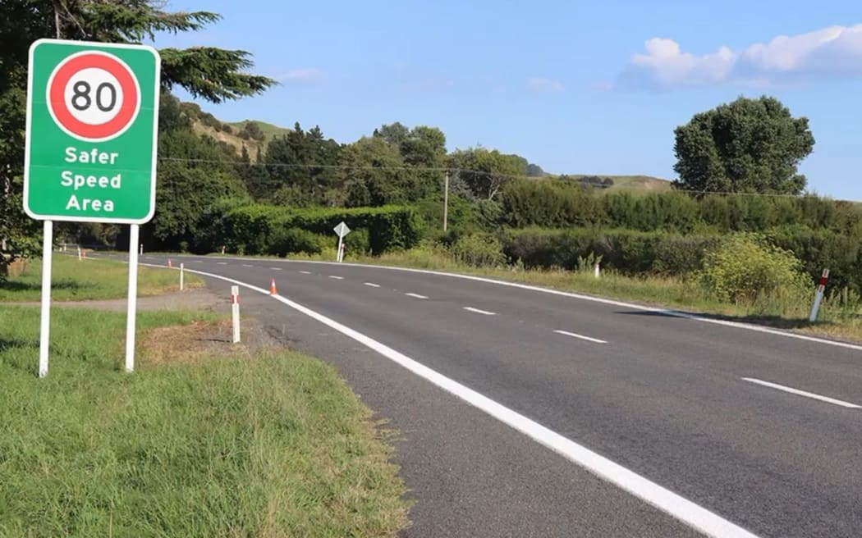
Live Demo
Visualization page to be shown.
The Auckland to Hamilton State Highway and the Puhoi to Warkworth Highway project highlighted.

Slide 12
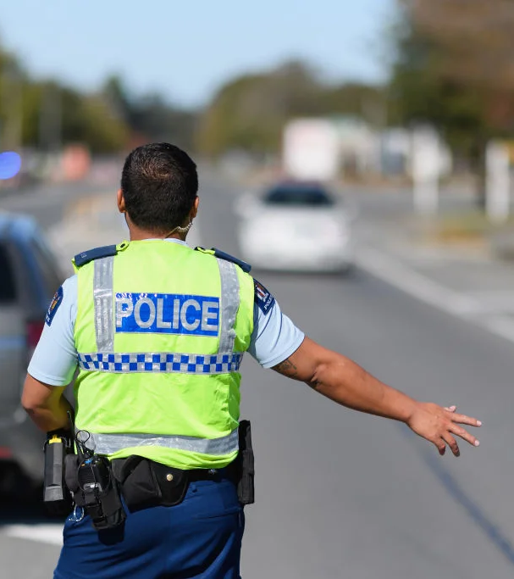
Questions?

